Slide 1

Quantum Algorithms Institute

Slide 2
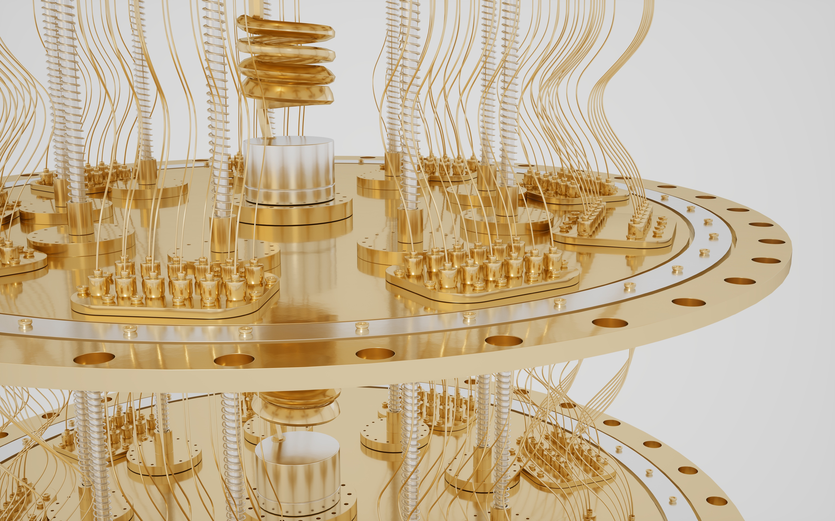
Louise Turner, Chief Executive Officer
  About QAI
  About Quantum Computing
  Quantum Skills and Talent
  Things to Do

Slide 3
About QAI

Slide 4









A Unique Partnership
Adding 1)quantum users &
2) quantum workforce

Slide 5
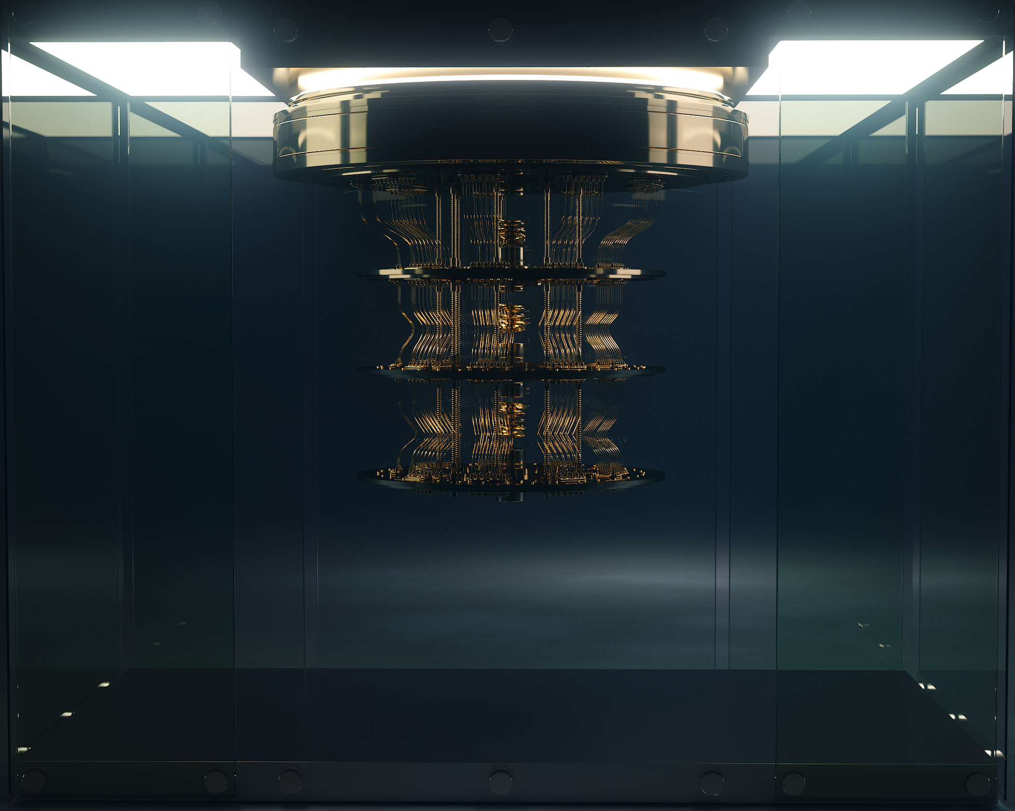
QAI’s Focus
  Quantum to advance Canadian businesses
  Economic development
  Focus on
    Quantum computing
    Quantum networking
    Post-quantum encryption
    Application of quantum algorithms

Slide 6
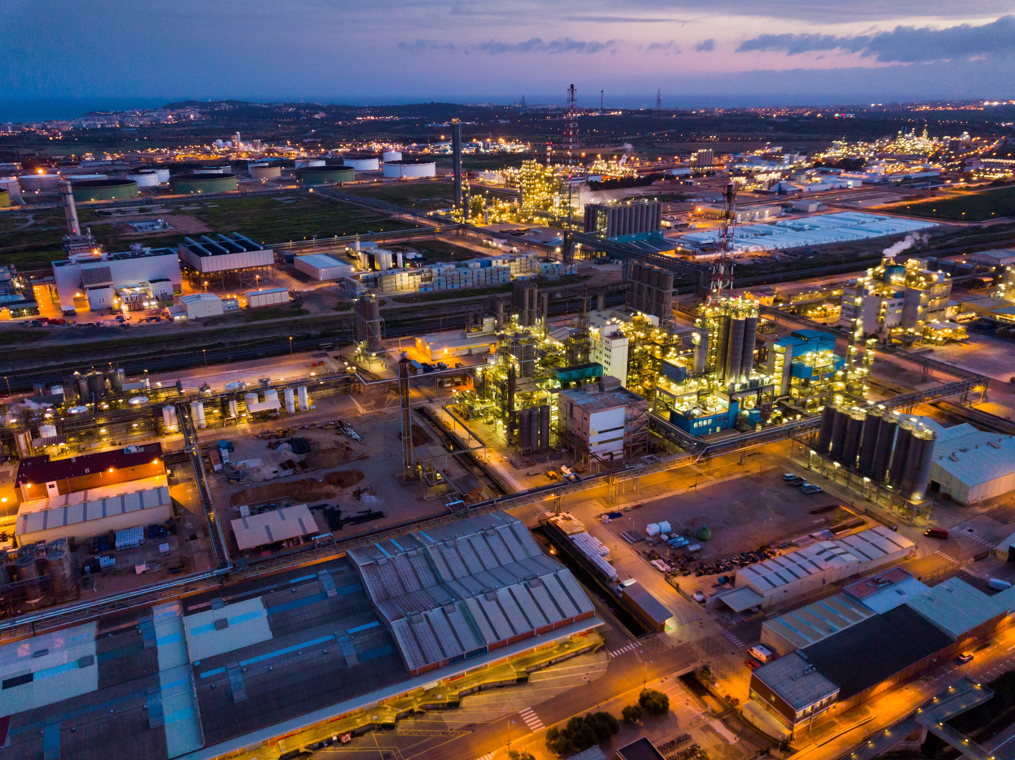


Three Streams of Business Activity
  1. Playing with the Real World
  2. Growing & Feeding Talent
  3. Ecosystem Hum

Slide 7
Playing with the Real World I
  Consult with quantum-curious companies
  Build quantum literacy
  Support applied quantum projects in BC companies
  Identify the right business problems to solve with quantum
  Match expertise from BC’s quantum community industry challenges
  Build expertise on use of quantum in the real world

Slide 8

Playing with the Real World II
  Quantum expertise in universities
  QAI network of Academic Affiliates
  Internships and work opportunities for students and new grads

Slide 9
Growing and Feeding Talent I
  Education & training for two priority groups
  Executive education for BC companies
    Quantum literacy
    Use quantum solutions in business
    Develop a quantum-literate workforce
    Build quantum-ready companies

Slide 10
Growing and Feeding Talent II
  Education & training for two priority groups
  2. “Quantum Proximate” grads & post grads
    Math
    Stats
    Physics
    Chemistry
  Biochemistry
  Computer Science
  Engineering

Slide 11
Ecosystem Hum
  QAI as…
  A physical hub for quantum activities, events and programs
  An online resource to access quantum materials and expertise
  A facilitator for quantum projects and applied research
  A location for BC’s quantum community to gain access to quantum computers & hardware
  A sponsor and supporter of quantum events

Slide 12
About Quantum Computing

Slide 13

Computing with Qubits
Programming
Atomic Size
Algorithms
Non-Newtonian
Environmentally
Sensitive
Superposition
Vacuum Technology
Interference
Photonics
Entanglement
Cryogenics
Affected by
Measurement
Nanotechnology

Slide 14


The Quantum Opportunity I
Up to US$ 850 billion in value
from 2021 to 2051
  Four Types of Problem
  Simulation
  Optimization
  Machine learning
  Cryptography
A top pharma company with a
US$10bn R&D budget
30% increase in efficiency
US$2.5 billion in savings p.a.
5% increase in annual
operating profits
Calculation on Google’s Sycamore quantum computer
557,000 less energy than a classical supercomputer
Q4Climate

Slide 15
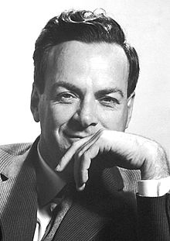



Quantum Computing Timeline
Quantum Supremacy
D-Wave
Founded
World’s First
Quantum
Computer
Feynman
1999
2011
2019
2021
1981
2022
1998
2012
2016
2020
First
two-qubit
computer
1QBit
Founded
Cloud
Quantum Computing
Falcon
27 Qubits
Eagle
127 Qubits
Osprey
433 Qubits

Slide 16
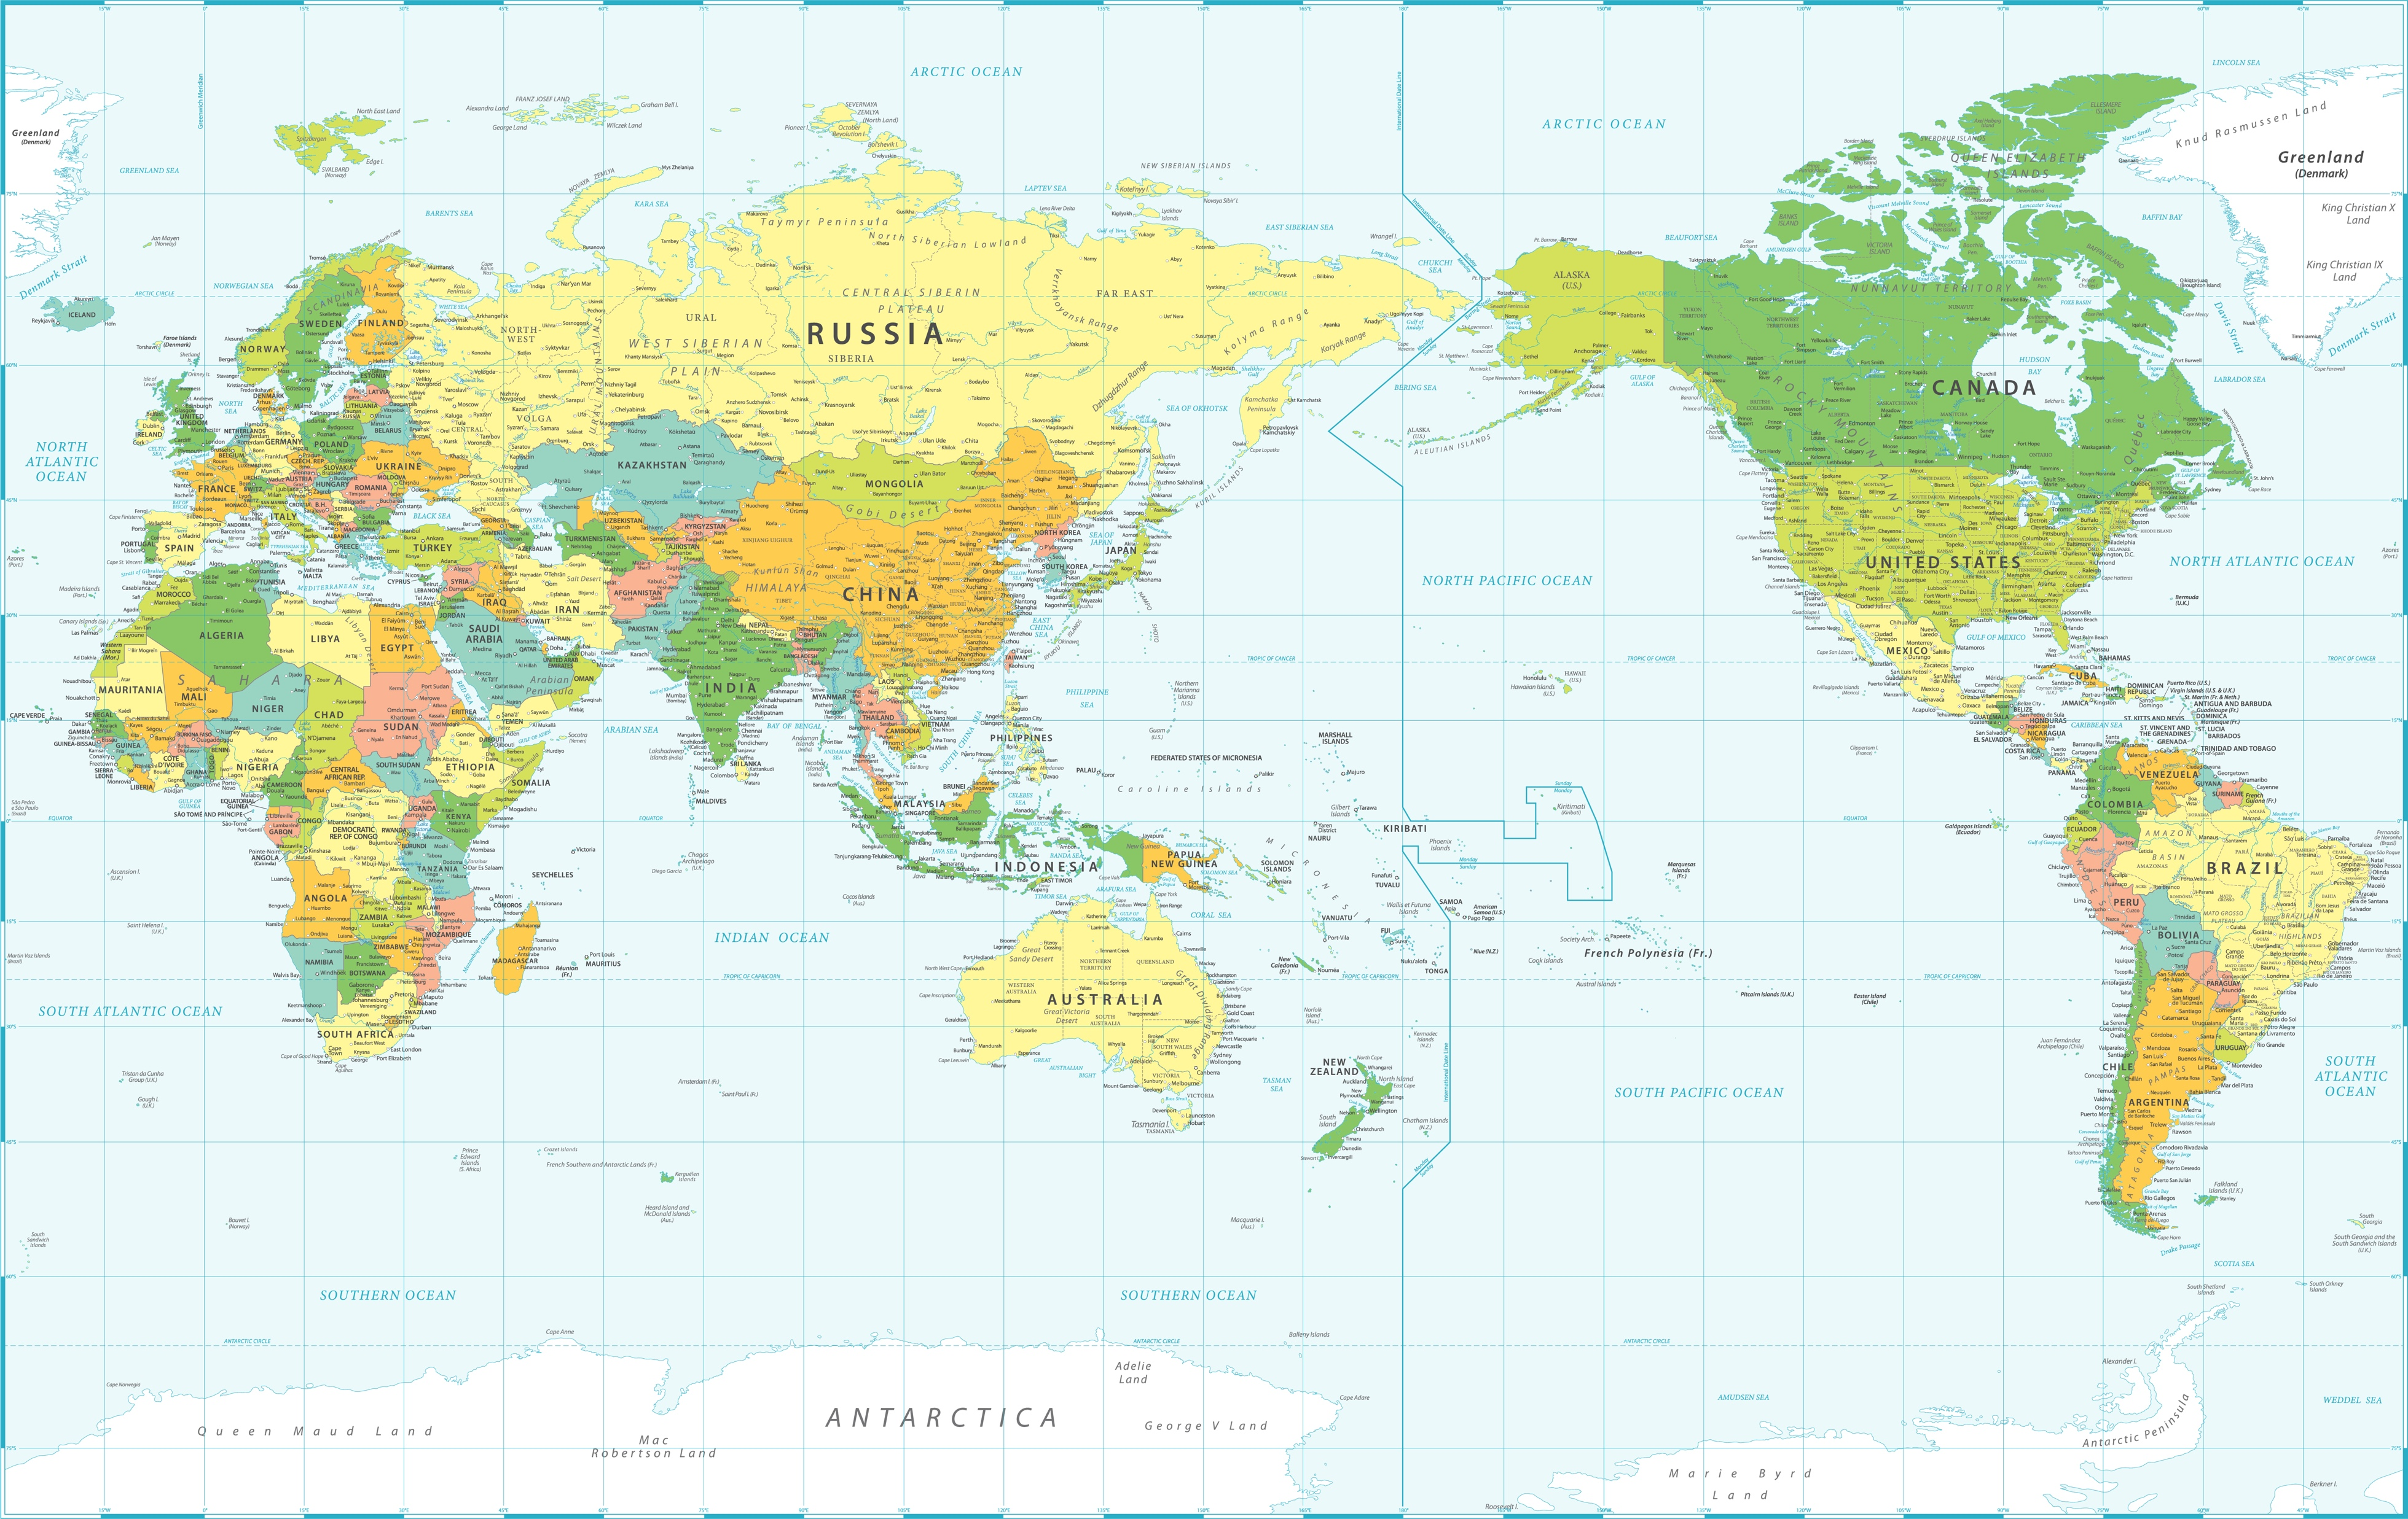



Acceleration of Investment
Public and private investments in quantum computing
National
quantum
initiatives
since 2016
15
US$ 35.5 billion
By 2022
Equity invested in quantum
computing companies
US$1.3 billion since 2018
2015: 42
2021: 195
2/3 of all quantum computing equity
World’s quantum computing companies

Slide 17

Quantum Computing Technologies
  Superconductors
  Trapped Ions
  Spin Systems
  Neutral Atoms
  Nitrogen Vacancy
  (NV) Centres
  T-Cells
  Photonic Simulators
  Error Correction
  Qubit Fidelity
  Reliability
  Scalability
  Quantum Software
  Classical to Quantum Conversion

Slide 18
Quantum
Skills and Talent

Slide 19
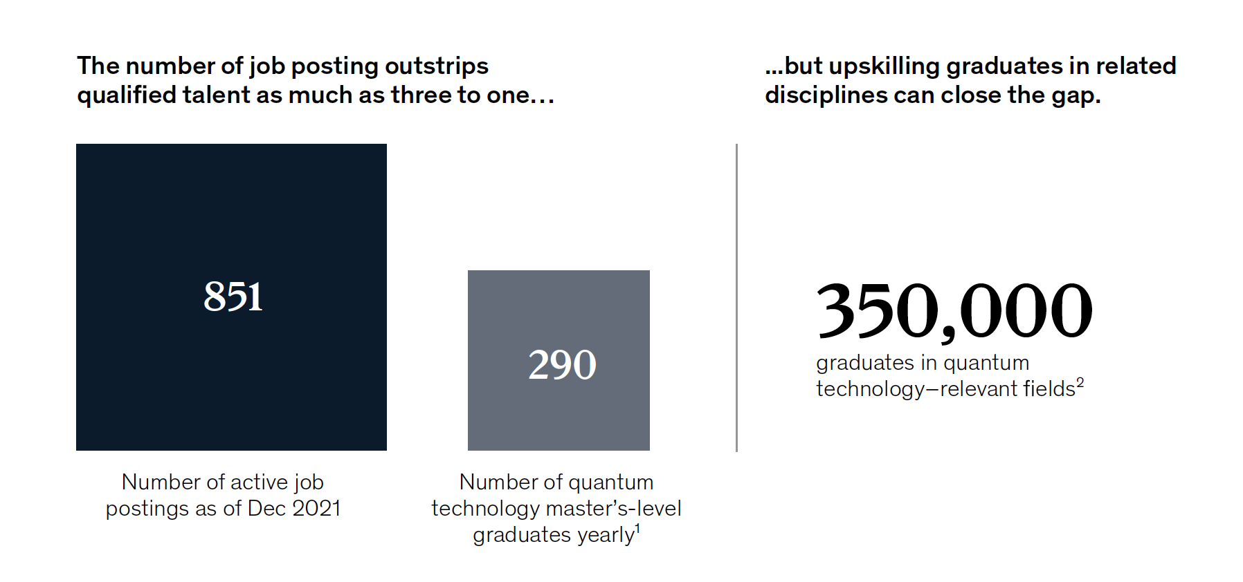
Quantum Talent Scarcity
Quantum tech
relevant fields
Math
Stats
Physics
Chemistry
Biochemistry
Computer Science
Engineering
Quantum research
programs = 176
Quantum Masters
programs = 29
McKinsey Data: 2021

Slide 20

Rapid Re-Skilling
  Quantum Algorithms Institute
    Survey of company needs
    Professional development curriculum
    Short courses & internships
  Pacific Institute for Mathematical Sciences
    Math to Power Quantum
    Short courses & internships

Slide 21


Longer Term STEM into Quantum
Let’s Talk Science is a national, charitable organization that motivates and empowers youth to fulfill their potential and prepare for their future careers and roles as citizens.
Let’s Talk Science supports learning and skill development using science, technology, engineering and mathematics (STEM).

Slide 22
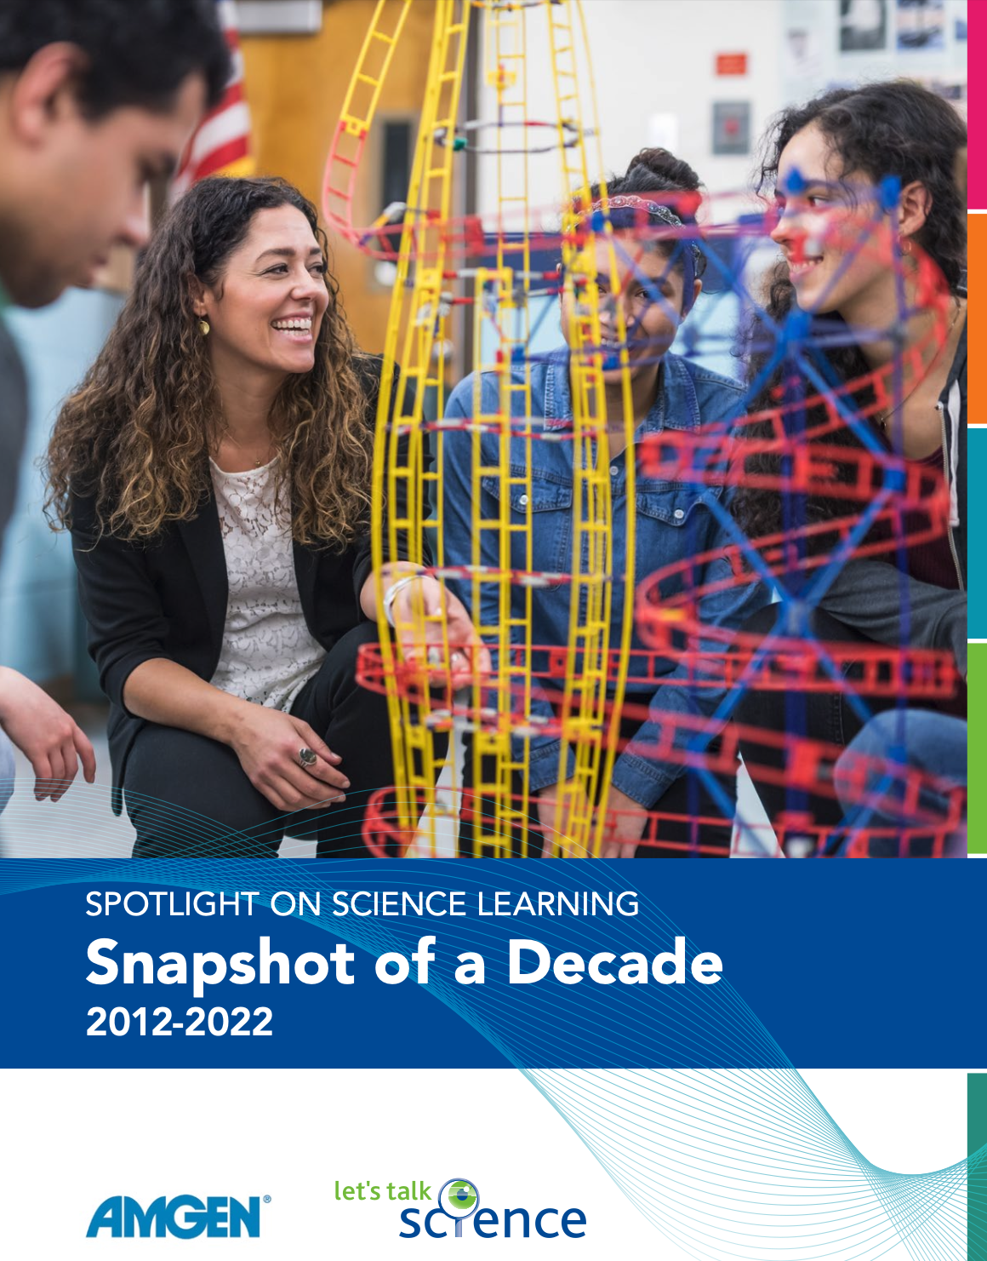

Ten Years of Research into STEM Learning
  Research in Partnership with AMGEN
  Consistent and practical approach to improving STEM education & outcomes

Slide 23
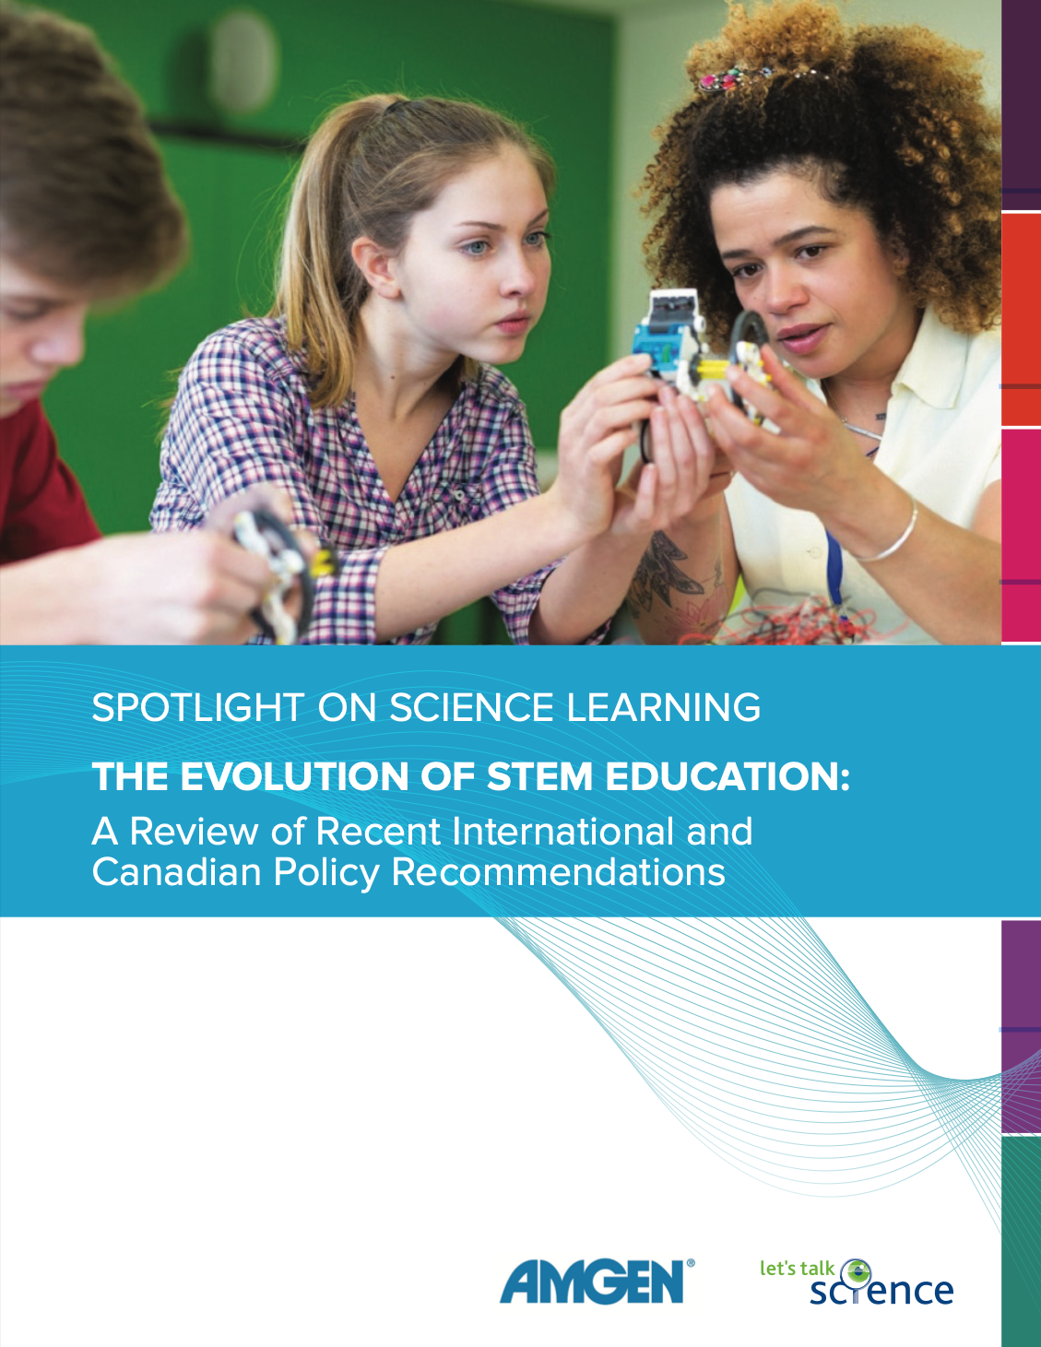
2017 Review of Policy Recommendations
  How We Teach
  The strongest consensus relates to the importance of teacher education and professional development. The concern is not that teachers are poorly educated, but that too many of those who teach math and science are not specifically educated in those disciplines and in the best ways to teach them.
  There is agreement that, to be successful, STEM education needs to be delivered by STEM specialists, even in the early years of education.
  There is also agreement that STEM teachers need to be provided with professional learning and development opportunities, and that these opportunities must be sustained and activate collaborative learning communities among teachers within and among schools.

Slide 24
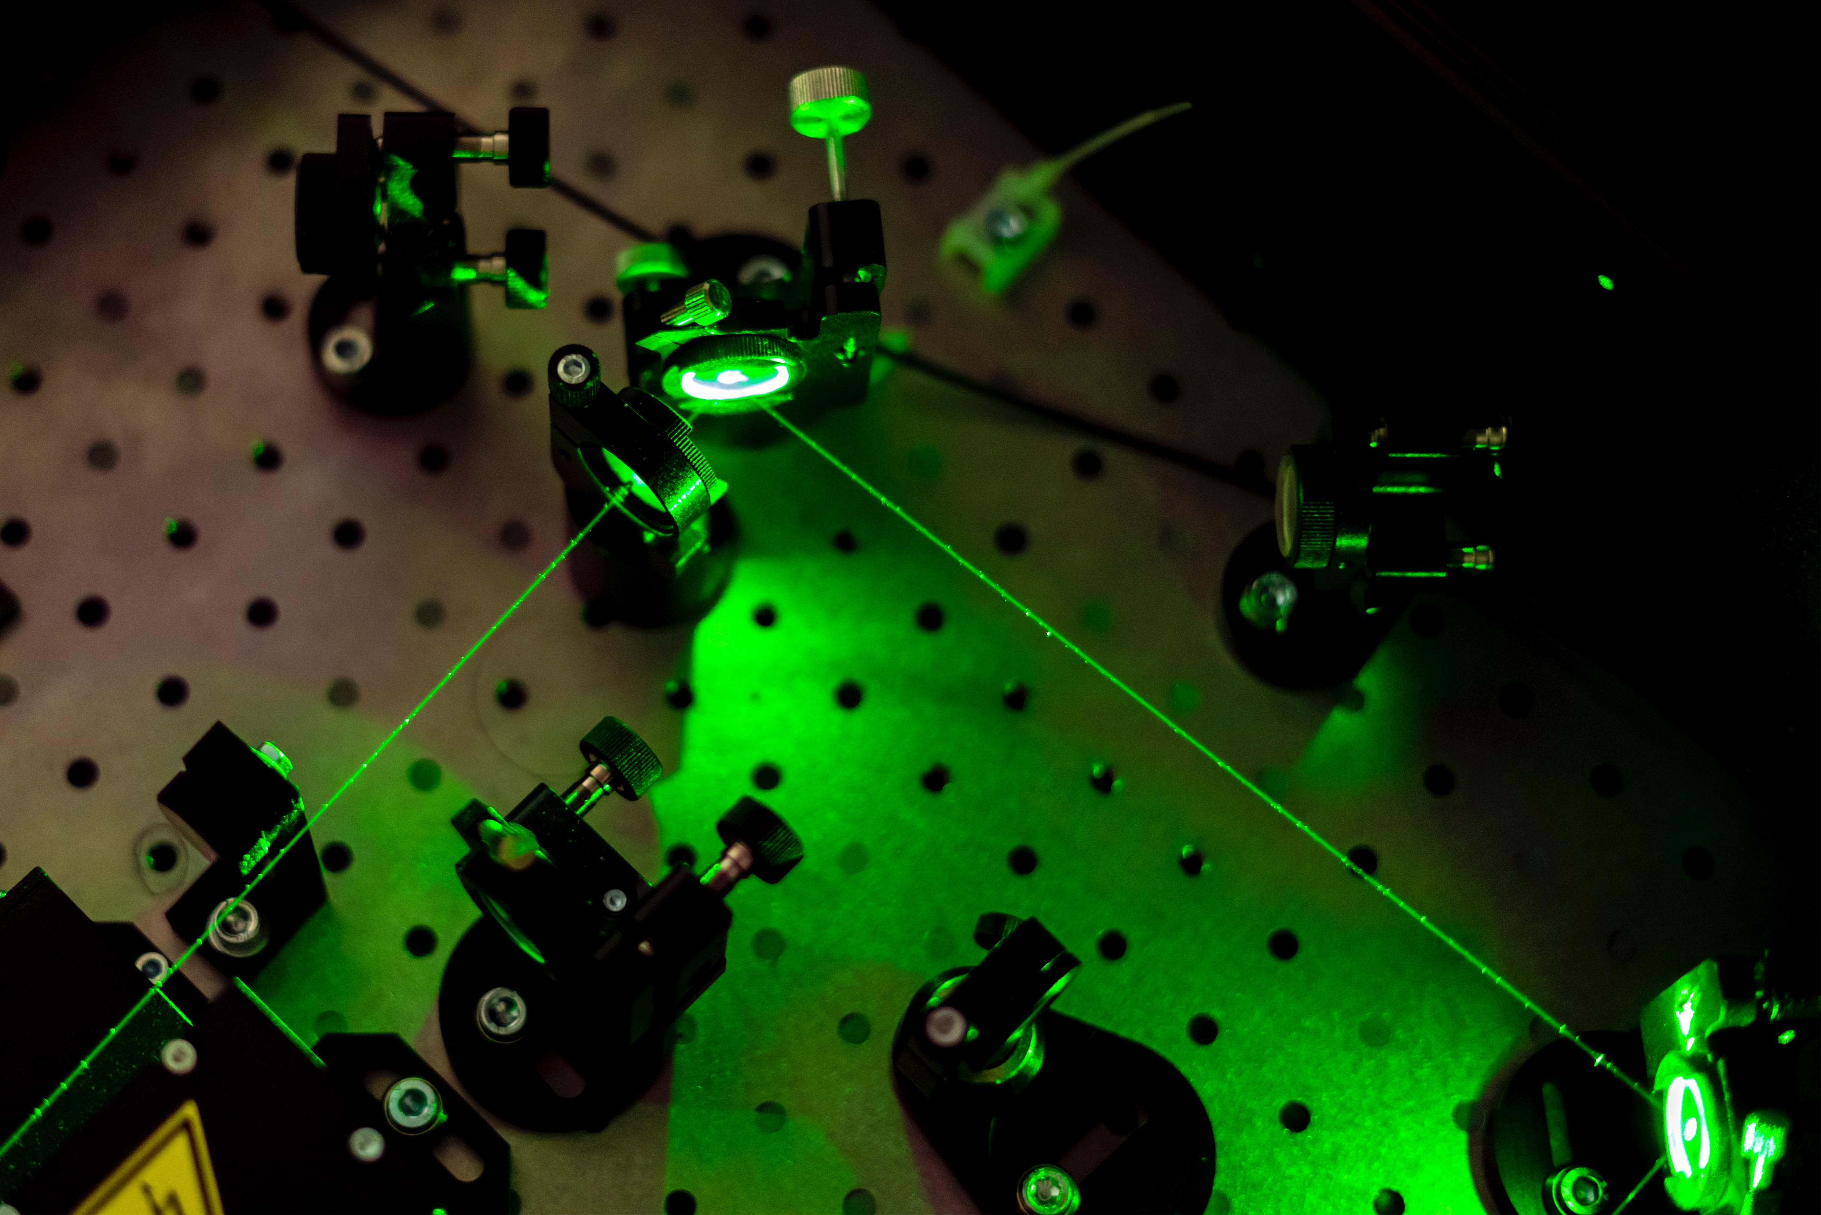
Hints and Tips from PRIMA Experts
  Teaching and Learning
    Ideas & Experience
  Rapid Upskilling
  Longer term talent development

Slide 25
Things to Do

Slide 26
Market Overview
State of Quantum Computing: Building a Quantum Economy
World Economic Forum Insight Report
  September 2022

Slide 27
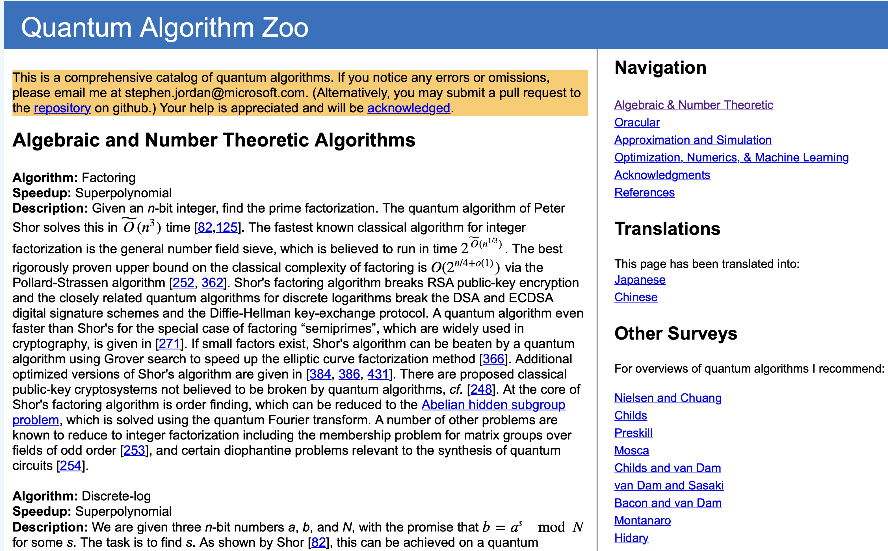
QuantumAlgorithmZoo.org

Slide 28
Join PIMS
  Pacific Institute for Mathematical Sciences
  https://www.pims.math.ca

Slide 29
Join the QAI Mailing List
  For future newsletters
  Applied research projects & opportunities
  Internship opportunities for undergrad and grad students
  Academic Affiliate programs
  Collaboration on quantum curriculum development & education
QuantumAlgorithms.ca
contact@bcqai.ca

Slide 30
Questions or Comments?
    Louise Turner
    louise.turner@bcqai.ca

