Slide 1

Conjugates, paths,
and groups of
Andrés Navas, USACH and UNAM

Slide 2
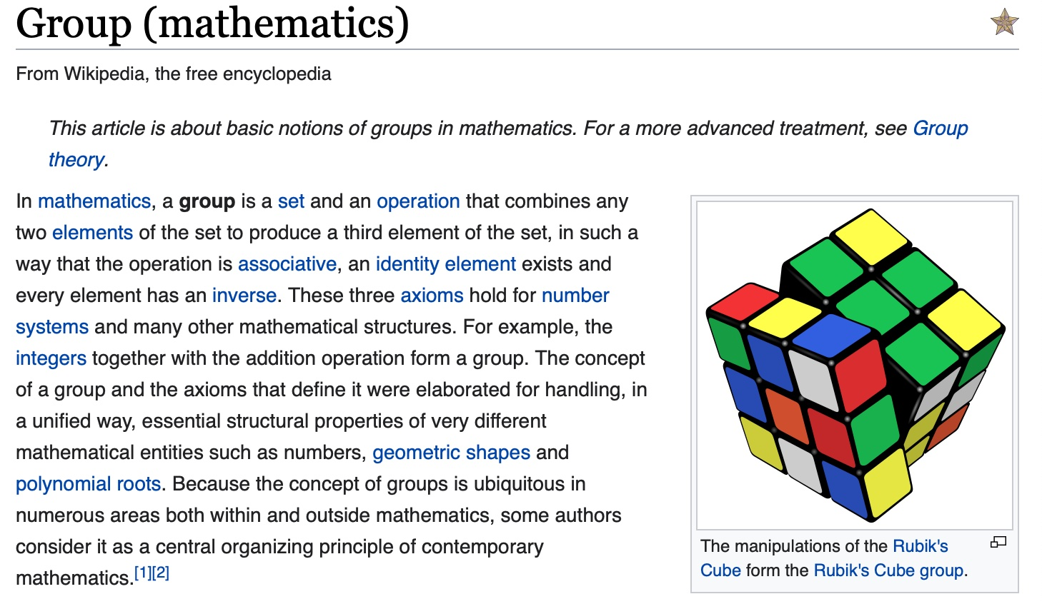

Slide 3
The genesis of groups
Groups can be approached in many ways: pure algebraically
(axiomatically), combinatorially, geometrically, dynamically,...
Galois invented groups, but one can argue that it was Cayley (Dedekind) who opened the path to a wide understanding of groups...

Slide 4
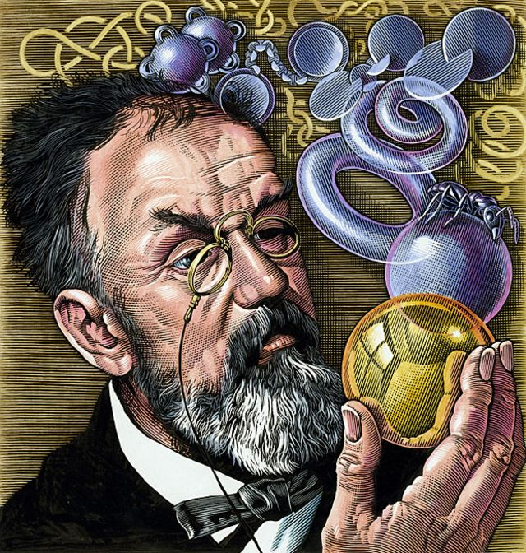
“Les mathématiques ne sont qu’une histoire de groupes”
(H. Poincaré).

Slide 5
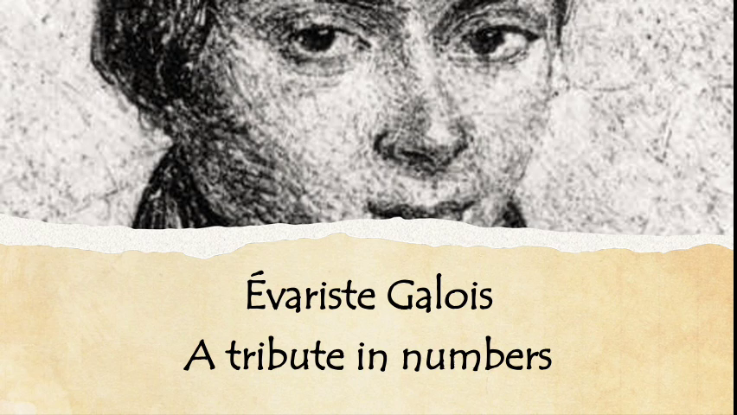

Slide 6
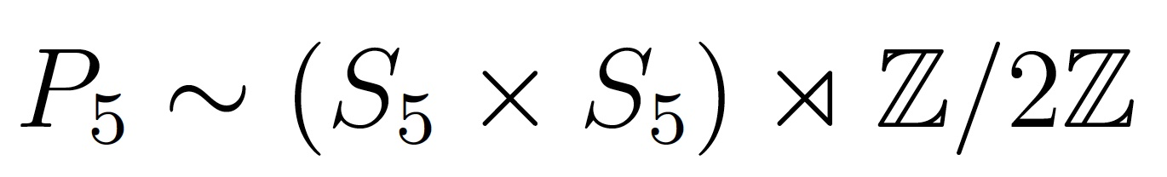
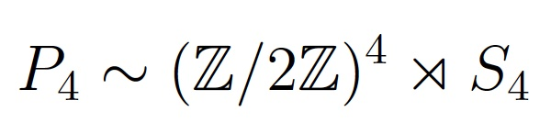
Panmagic groups
The panmagic group is the group of permutations of the cells of a square that preserve the panmagic relations: they send panmagic squares into panmagic squares.

Slide 7

The algebraic
theory of
diabolic
magic squares.
B. Rosser & R. Walker
Duke Math. J. 1939

Slide 8
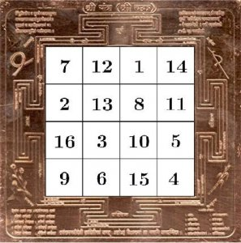
Theorem
(Narayana Pandit,
B. Rosser & R. Walker,
H. Coxeter,
W. Müller, N.):
The 4x4 panmagic group has order 384, and is isomorphic to the group of symme-tries of the hypercube.

Slide 9
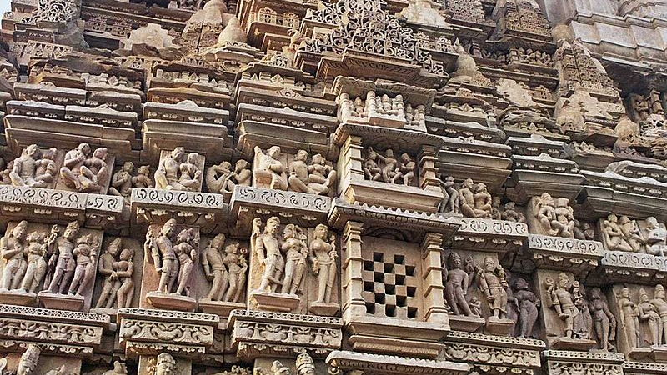
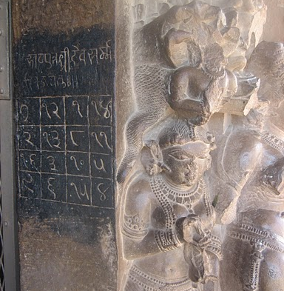
The Chautisa Yantra at Khajuraho
(centre of India)

Slide 10

Des carrés magiques en cadeaux.
Le carré magique de Khajuraho est un hypercube.
- If you get an idea for computing P₇ please tell me !
- In any case, you will lear how to build your own magic square...

Slide 11
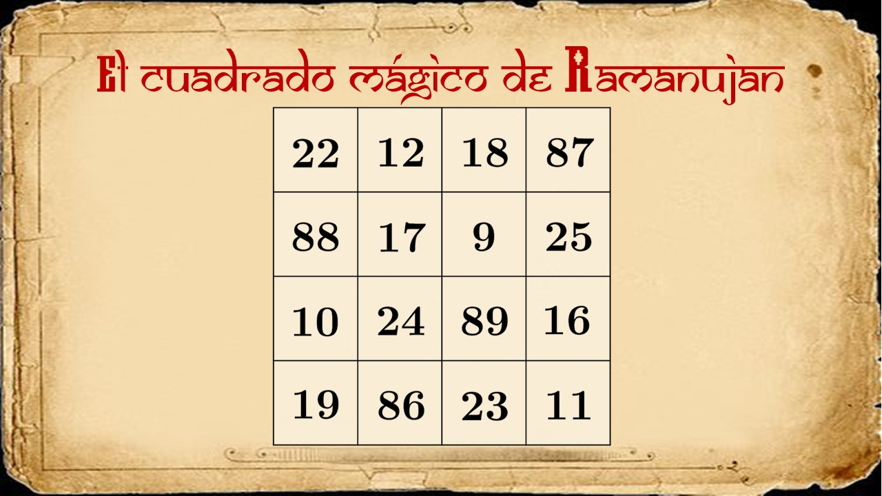
Ramanujan’s magic square

Slide 12
Groups as dynamical objects I
Every group is a subgroup of the group of permuta-
tions of some object (Cayley).
Proof: The group acts on itself
(on its Cayley graph if finitely generated).

Slide 13
Groups as dynamical objects II
Every countable group can be realized as a group of
homeomorphisms of the Cantor set:
G acts on {0,1}^{G}
Homeo (C) contains all countable groups !

Slide 14
Simple amenable groups
Start with a homeomophism T of the Cantor set C.
Then let G be the group of homeomorphisms of C obtained this way: for each element g of G there is a partition of C into finite-ly many clopen sets C _{i} so that the the restriction of g to each C _{i} is the restriction of some power (iterate) of T.
Theorem (Matui; Juschenko - Monod): If T is properly chosen, then [G,G] is finitely generated, simple and amenable.

Slide 15
From 0 to higher dimension
Diff ^{r} (M) keeps all the information about the mani-fold: it recognizes both M and r (Filipkiewicz; Mann, Hurtado, Kim - Koberda - de la Nuez González).
The connected component of these groups are algebraically simple (Herman, Thurston, Mather).
Remaining open case: r = dim (M) + 1
Warning: Diff ^{1+bv} ( S¹ ) is not simple (Mather).

Slide 16
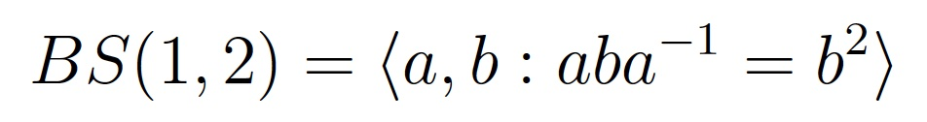
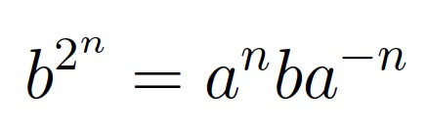

Can these groups be distinguished “geometrically”
Definition: an (infinite order) element a in a finitely generated group is distorted if the powers a^{n} may be written as products of o(n) number of generators (and inverses).
Definition: an element of a general group is a distortion element if it is distorted inside some finitely generated sub-group (Gromov, Rosendal).

Slide 17
An obstruction and
“two” specific examples
- If a diffeomorphism has a hyperbolic fixed (periodic) point, then it is undistorted in the group of C¹ diffeomorphisms.
- Every irrational rotation of the circle is distorted in the group
of circle diffeomorphisms (Avila).
- Irrational rotations are also distorted in the group of piece- wise affine circle homeomorphisms (Banecki & Szarek).

Slide 18
Distorted diffeomorphisms
Problem: Given r > s ≥ 1, give examples (or prove that there exist) C^{r} diffeomorphisms that are undistorted in Diff ^{r} but distorted in Diff ^{s}
Only one “relevant” example known: r = 2, s = 1, M = S¹ , [0,1].
(N; Dinamarca-Escayola).
Warning: These diffeomorphisms have no hyperbolicity behaviour (vanishing topological entropy).

Slide 19
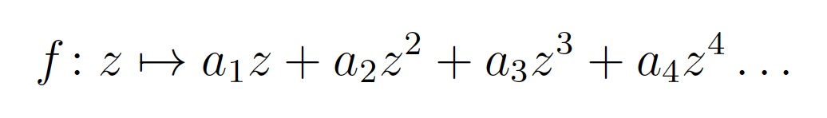
Germs
G = germs of analytic diffeomorphisms at the origin.
Group operation: composition !
Theorem (Cerveau, Cantat, Souto): This group contains the funda-
mental groups of compact surfaces.
Producing a free subgroup inside G is already interesting...

Slide 20
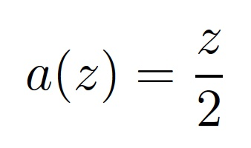

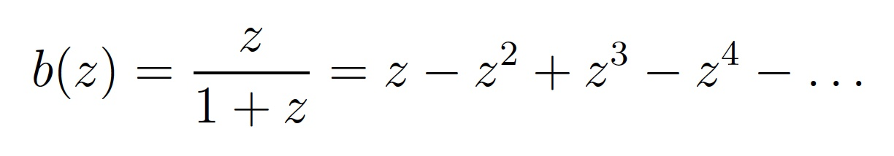
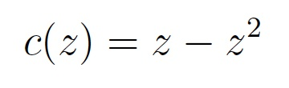
Another challenging question
The two maps below generate a copy of BS (1,2) in G; in particular, the second one is a distortion element of G.
Question: Is
a distortion element ?

Slide 21
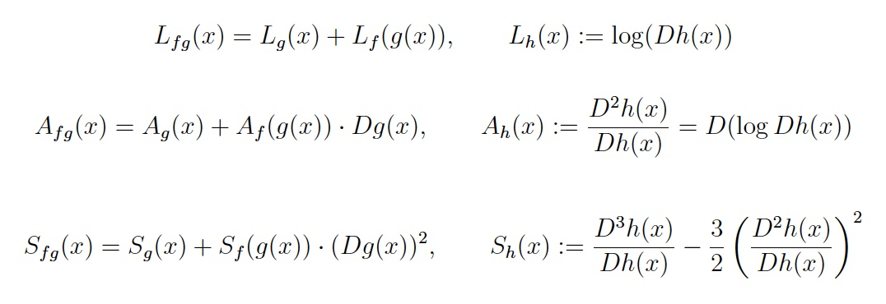
Three derivatives, and more...

Slide 22
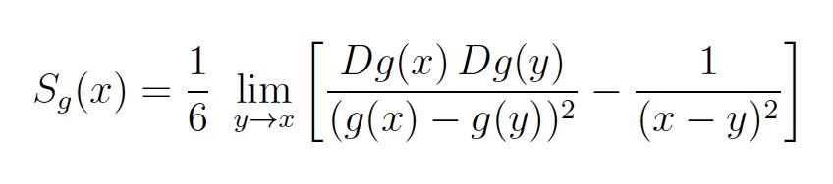
A nice formula for the Schwarzian derivative

Slide 23
Thurston’s stability theorem
Thurston’s trick: If G is a finitely generated group of germs of C¹ diffeomorphisms at the origin, then there exists a nontrivial homomorphism G → R.
“Proof”: g → L_{g} (0) = log (Dg (0))
But... what happens if this homomorphism is trivial ?

Slide 24
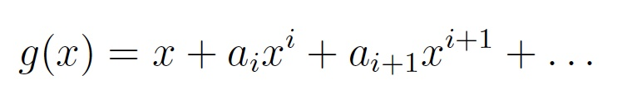
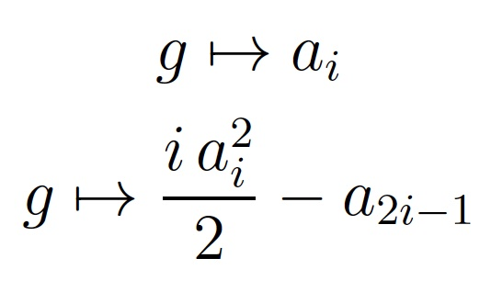
If more derivatives are available...
Two group homomorphisms:

Slide 25
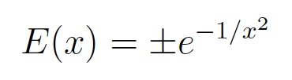
The spirit of the proof
Exercise : The conjugate by E ⁻² of every germ of C^{k} diffeo-
morphism at the origin is the germ of a C^{k} diffeomorphism
that is tangent to the identity up to order k (Muller-Tsuboi).
Thurston’s idea: “Renormalize” the geometry near the origin in order to create something like a nontrivial (logarithmic) derivative

Slide 26

Some consequences
Thurston’s stability provides many examples of groups that, though acting by homeomorphisms on an interval, do not act by diffeomorphisms.
Example: braid groups B_{n} , n > 4
(Dehornoy; Dehornoy-Rolfsen-Wiest; Nielsen-Thurston).
This is not the only obstruction !
(Calegary, N, Bonatti-Monteverde-N-Rivas, ...)

Slide 27
Property (T) also gives an obstruction
A group G has property (T) if every action by isometries on a Hilbert space has a fixed point (Serre).
Can reformulated in a cohomological language: every cocycle with respect to an unitary representation is a coboundary.
Theorem (N): Every f. g. group of C^{3/2} diffeomorphisms of the
circle (resp. interval) is finite (resp. trivial).

Slide 28
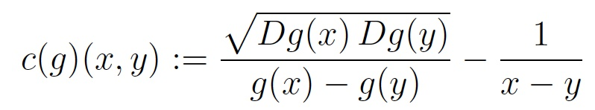

A tool for the proof:
Key point : If g is a diffeomorphism of class C^{3/2} ,
then c(g) belongs to
(although (x,y) → 1/ (x - y) does not !)

Slide 29
Life is not always smooth
Question: Does there exist an infinite group of circle homeo-morphisms with property (T) ?
Negative direction: Witte-Morris, Ghys, Deroin-Hurtado
Positive direction: Ozawa ...
Question: Does there exist an finite group with property (T) which is left orderable ?

Slide 30
Obstructions arise in any regularity
Theorem (Kim - Koberda; Mann - Wolf) : For every r > s ≥ 1, there exists a finitely generated group of C^{s} diffeomorphisms of the interval / circle that does not embed into Diff ^{r}
Very simple general questions remain open in higher dimension:
Question: Does there exists a f. g. torsion-free group that does NOT embed into the group of homeomorphisms of the plane ?
Candidates / tools: Monsters ? (Tarski, Osin, ...)
Very important recent achievements; e.g. solution of the Zimmer conjecture by Brown-Fisher-Hurtado (lattices do not act unnaturally...). Related to classical results of Mostow, Margulis, ...

Slide 31
Groups that do act !
Take two maps “at random”. Then they will generate a free group.
Warning: No two piecewise affine homeomorphisms of the interval
will generate a free group (Brin-Squier).
Take a diffeomorphism “at random”. Then the set (group) of
diffeomorphism that commute with it is reduces to its powers.
“A generic diffeomorphism has a trivial centralizer”
(Smale, Kopell; Palis, Yoccoz, ... ; Bonatti-Crovisier-Wilkinson)
In general, diffeomorphisms do not arise from vector fields (Palis, Milnor...)

Slide 32
Spaces of diffeomorphisms
Studing the space of diffeomorphisms of a manifold is already difficult (homotopy type, etc).
Example (Alexander): The space of homeomorphisms of a ball is contractible.
Theorem (Smale): The space of diffeomorphisms of the sphere has the homotopy type of SO(3).

Slide 33
Spaces of commuting diffeomorphisms
- Almost nothing is known, even in dimension 1 !
Question (Rosenberg): Is it locally path-connected for S¹ ?
This was (indirectly) treated by Yoccoz in his thesis...
Theorem (Hélène Eynard-Bontemps - N): The space of C^{1+ac}
commuting diffeomorphisms of the circle is path connected.
- Also true in class C¹ but much easier (and less interesting...).

Slide 34
Two naive approaches
Alexander trick works well at least for commuting homeomor-phisms of the interval, but it does not preserve regularity...
A homeomorphism of the interval can be sent by a linear ho-motopy (of its graph) to the trivial one, but this procedure does not preserve commutativity...

Slide 35
Several pitfalls along the path
If f is a C² circle diffeomorphism with no periodic point, then it is conjugated to a rotation (Denjoy).
The same holds for commuting diffeomorphisms (simultaneous conjugacy).
Pitfall: in general, the conjugacy is not smooth (Arnold, Herman, Yoccoz, Moser, Pérez-Marco, Fayad-Teplinsky, ...)

Slide 36
Another pitfall
If f is a C² diffeomorphism of the interval [0,1) with no fixed point
at the interior, then it is the time-1 of a flow (Szekeres).
Work of Kopell clarifies the situation for commuting maps.
Pitfall: In general, the flow is not more regular than C¹ (Sergeraert).
- It may happen that such a diffeomorphism has no C² square root...
- It may happen that the C² maps of the flow are those that arise
from combinations of two irrationally independent numbers (E-B).

Slide 37
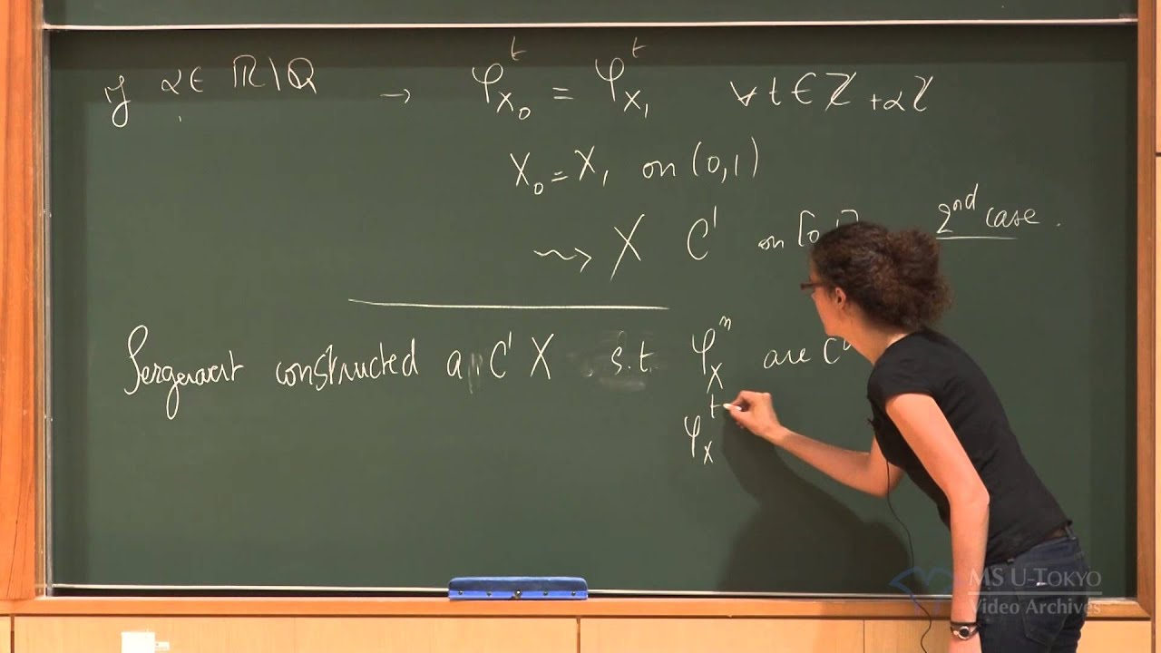

Slide 38
Still another pitfall
If f is a C² diffeomorphism of [0,1], then there are two (Szekeres) vector fields (left and right).
Pitfall: these may be different (Mather, Yoccoz).
But, some structure arises. For instance, if these vector fields are different then the C¹ centralizer is infinite cyclic (Mather, Yoccoz).

Slide 39
A key idea: paths of conjugates
Inspiration: a parabolic element in Mob is conjugate to its roots...
Try to conjugate a group action so that it becomes closer and
closer to the trivial action (or, at least, to an action by rotations).
In C⁰ topology: given f g = g f, we want h _{t} such that
h _{t} f h _{t}⁻¹ → R₁ h _{t} f h _{t}⁻¹ → R₂
Always possible !

Slide 40
A first obstruction
Hyperbolic fixed points are invariant under C¹ conjugacy...
Theorem (N) : Hyperbolic periodic points are the only obstruc- tion to conjugate a circle diffeomorphism to diffeomorphisms close to rotations.
Key observation: Hyperbolic periodic points are detected by the
growth of the logarithmic derivative: L (g ^{n})

Slide 41
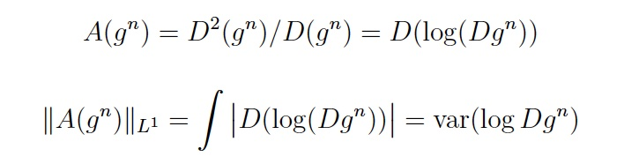
A second obstruction
In class C^{1+ac} , the problem is related to the growth of the affine derivative:

Slide 42
A structure result
Theorem (N, Eynard Bontemps-N): The growth of the affine derivative is linear only in two cases:
- presence of hyperbolic periodic points;
- dynamics on the interval for which left and right vector fields do not coincide (here, Mather’s theory applies...)
- In case of sublinear growth, the affine derivative is “almost a coboundary”, which means that the action can be conjugated to actions closer and closer to rotation actions...

Slide 43
Summary:
We do affine interpolation but not of the graphs...
We interpolte derivatives !!!
Since these are cocycles, we can keep the commutativity relation along the path.
We detect the possible obstructions: these are related to the growth of the derivative cocycles.
We use / establish theorems for the cases where these obstructions actually appear.
With some extra (somewhat painfull) work, this gives a proof...

Slide 44
A last pitfall
Very surprisingly, hyperbolic fixed points are not so easy to handly because... they may be non linearizable !
Theorem (Eynard-Bontemps - N): there exist plenty of non-linearizable C¹ vector fields...

Slide 45
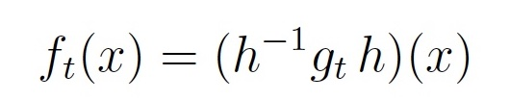
A last exercise
f_{t} is a flow of C^{1+ac} diffeomorphisms with the same multiplier as e ^{- t} yet the conjugacy h is not bilipschitz...

Slide 46


